Slide 1
Malaria KAP Baseline Study
Local and migrant communities in Phuket
December 2010

Slide 2
Outline
Summary & Recommendations
Lessons Learned
Background & Objectives
Methodology
Key Segment Profiles
Knowledge About Influenza Like Illnesses
Preventative Behavior
Health Seeking Behavior
Media Penetration & Usage
Appendix: Profiles of Migrant Camps

Slide 3
Summary: Risk Profile Segmentation
The following table summarizes the different elements that contribute to the risk a Thai or migrant faces in relation to ILIs. In terms of segmenting the market the only sensible variable found that consistently indicated differences in terms of risk exposure was migrant registration status. Hence, from a communication point of view it makes sense to consider unregistered migrants as higher risk group both in terms of their ability to protect themselves as well as in terms of how to effectively reach them.
For an easy overview, a traffic light scoring system is used here where RED=High risk, Amber=Moderate risk and Green=Low risk. It should be noted that the colors are used more to differentiate between the segments rather than indicating an exact risk level.
In the next section each risk element will be dealt with in turn followed by recommendations for potential communication strategies.
Risk Element | Thai | Registered Migrants | Unregistered Migrants
Demographic profile
Knowledge
Vector conditions
Risk Exposure
Protection: Malaria
Protection: Dengue
Protection: Influenza
Provide Blood Samples
Seeking appropriate care
Protecting children
Medicine
Treatment follow up
Media Access
Mobile phone Access
Exposure to health messages

Slide 4
Summary: Risk Profile Segmentation
Thai Communities | Registered Migrants | Unregistered Migrants
Demographic profile
Earn on average more than 10,000 Baht per month Thai literacy 100% Most have junior high school education | Earn on average around 10,000 Baht per month 72% can speak Thai but only 1% are literate 50% have only elementary school education | Earn less than 10,000 Baht per month 53% can speak Thai 50% have only elementary school education
Knowledge
Fully aware of ILIs, especially dengue and pandemic influenza where knowledge about symptoms, transmission routes and how to block transmission is high. However, they are somewhat weaker on malaria and there is confusion about the risks associated with day and night time mosquitoes. | Not all migrants are aware of ILIs. Apart from malaria there are clear knowledge gaps in relation to symptoms, transmission routes and how to block transmission. Migrants have misconceptions about ILI transmission routes and as with the Thais, there is confusion about day and night time vectors.
Vector conditions
The Thai households keep the surroundings of their homes clear from water collecting containers. However, because they live near the camps there is still a certain amount of risk that vectors will be present. | The migrants also keeps their surroundings clear from water collecting containers. However, more than half the camps have an abundance of water collecting containers lying around and in some camps garbage is left accumulating creating a situation where potentially harmful vectors can thrive.

Slide 5
Summary: Risk Profile Segmentation
Thai Communities | Registered Migrants | Unregistered Migrants
Risk Exposure
27% of the Thais surveyed use neither window screens nor nets. | Whilst migrants don’t use window screens, most use nets. | Unregistered migrants use nets to a lesser extent than registered migrants.
Protection: Malaria
Some 40% of Thais don’t use screens nor nets on a regular basis. There is an attitude that they don’t need it. | Even migrants who are not aware of malaria use nets. 90% of the nets observed were in good condition. So whilst the connection between night time mosquitoes and malaria is vague, most still protect themselves. | Unregistered migrants use nets to a lesser extent than registered migrants.
Protection: Dengue
Due to the confusion between day and night time mosquitoes, it seems many believe nets help against dengue. Hence, repellent is seldom used. | Migrants spending much of their time outside both during work and during off hours. Whilst migrants claim they use repellent to a greater extent than Thais, fewer migrants were found to have repellent at home.
Protection: Influenza
People may cook poultry thoroughly and wash their hands with soap but they are likely to sneeze in their hands (not elbow). | Migrants have similar behavior to Thais but one third are not aware of pandemic influenza nor infection prevention. Also, nearly every camp was observed to have chickens and/or ducks running around freely.

Slide 6
Summary: Risk Profile Segmentation
Thai Communities | Registered Migrants | Unregistered Migrants
Provide Blood Samples
90% of the Thais would be willing to provide a blood sample. However, some Thais may hesitate and would only participate if they thought they were ill. | There is nothing to suggest that migrants would not participate and provide a blood sample.
Seeking appropriate care
If a Thai person came down with high fever and cold shivers, they would seek advice from a doctor and go to a hospital or clinic for care. | Migrants would also seek advice from a doctor and would hope to go to a hospital or clinic. However, there are potential barriers such as their lower socioeconomic status, status as migrants and distance to nearest clinic or hospital. However, it seems that language is not a major barrier as most of them can speak some Thai and some speak English.
Protecting children
These is little doubt that Thais would take their child to a clinic or hospital. | Whilst there is a stronger intention to protect a child, the potential barriers would still apply here. | Unregistered migrants are less at risk in this area since only 8% have children under 5 years.
Medicine
Past behavior indicates that Thais will purchase medicine and many will buy it in the pharmacy. | Fewer migrants have bought medicine in the past and may indicate that they wait to see if symptoms go away.
Treatment follow up
If the hospital or clinic prescribe medicine, both Thais and migrants will take it as prescribed but some Thais may stop taking the medicine should the symptoms disappear. Both groups will go back for check up but some Thais may only do it if they are told. This indicates that treatment is likely to be followed through should a Thai person or migrant be admitted for an ILI.

Slide 7
Summary: Risk Profile Segmentation
Thai Communities | Registered Migrants | Unregistered Migrants
Media Access
All Thais have good access to media including television, radio and newspapers. One third also have internet access. | Some 31% have no access to any media. Less than two thirds watch television every week. | Some 49% have no access to any media. Less than two thirds watch television every week.
Mobile phone Access
Some 93% have a mobile phone and 55% have a memory card slot. Have more extensive usage of features such as SMS (34%)and Bluetooth (19%). 100% can SMS in Thai. | Some 61% have a mobile phone (53% for unregistered migrants) and 35% have a memory card slot. Have less extensive usage of features such as SMS (21%)and Bluetooth (9%). And only 4% are able to SMS in Thai. Most have to use English as Burmese characters are not supported.
Exposure to health messages
Thais obtain most off their health related information in main stream media and through HCWs. Hence, PSAs will reach the vast majority through television and radio. | Only around 50% of migrants can be reached through main stream media but then there are language issues to consider as well. The local HCWs are doing a fine job, reaching around 50% and it is likely they are stretched to do any more than that. Migrants rely heavily on advice through their network of colleagues and friends and to a lesser extant on their employers.

Slide 8
Recommendations for Communication
Channels for Thai Community
For the local Thai population it is straight forward, they can be reached through main stream media with PSAs. The ideal main channel to use would be television with scheduled messages for late afternoon and evening. Frequency can be boosted through radio, preferably in the morning and at lunch time.
Information through HCWs and at hospitals and clinics, which probably is already in place, will help to reach those coming in for check up and with potential infections.
Channels for Migrants
Migrants cannot effectively be reached through main stream media and need to be reached on the ground in the camps. The fact that migrants from Burma are normally closely networked with each other is a potential advantage. Channels that can build on this network, and create form of ‘viral campaign’ through human interaction, is a good idea. The key would be to identify and select suitable individuals who will be the initiators of the communication. There are several potential candidates:
Employers: They have an interest to keep their workers healthy but may need to be educated as well.
Migrant (Burmese and Mon) opinion leaders: They are most likely registered and have been in Thailand for some time so know many people. They probably can speak Thai so communicating to them would also be relatively easier.
Health Care Workers: They are already on the ground but may need support in the form of communication materials and capacity development for more effective communication.
Quite a few migrants have a working mobile phone and nearly all of them are using DTAC. There is strong potential to develop a Mobile Phone Panel with selected migrants in each camp. The panel could be used both to disseminate information as well as regularly collecting data to monitor camp conditions in relation to ILIs. It may be possible to also strike some sort of agreement with DTAC to obtain reduced call rates.

Slide 9
Recommendations for Communication
Messages for Thai Community
Whilst the Thai communities may be relatively well informed, they don’t always perceive the risks and there is a lack of understanding in terms of how to protect against different vectors. The best cause of action seems to be a push for window screens, nets and repellant. Much of the information available is quite overwhelming and not focused. Screens, nets and repellant has the potential to reduce the overall risk faced by Thai communities quite significantly. Focusing on reducing vectors does not seem as effective as this is not something people can really control if a neighboring camp is littered with water collecting containers.
Messages for Migrants
The starting point may be to reduce the favorable conditions for vectors. Maybe a campaign for a monthly camp clean up day. If there is potential to recycle some of the plastic containers can this be an incentive for someone to collect them?
As with the Thais, there is still potential to improve protection, especially for dengue and pandemic influenza. There should also be special effort made to distribute nets to unregistered migrants.
Because many migrants may not use the nets when it is hot there may be a need to further educate about the risks of malaria and night time mosquitoes. At present many may use their net just to avoid being bitten and hence, if it is hot outside, the discomfort of itchy bites may be forsaken for a cool breeze while sleeping.
There is a need for general education in relation to ILIs, especially pandemic influenza where one third is completely unaware.

Slide 10
Lessons Learned
The initial desk research looked at a number of reports and studies related to migrants and health seeking behavior in Thailand and other countries. The information was useful as a general background but since most studies are in the form of rapid appraisals the data is often not reliable and can not be generalized to a specific location such as Phuket. It was far more useful to meet and hold a dialogue with organizations who had had direct experience on the ground in Phuket.
Collaboration with other organizations for this project worked well and a lot of useful information was obtained, especially input for questionnaire development. Obtaining suitable Burmese and Mon speaking interviewers proved more difficult and because only registered interviewers can legally be used, most of them are already occupied with full time work. This lead to unexpected delays. Some Burmese interviewers were recruited from a boarding school but they quite within a few day due to extreme weather and generally harsh conditions working in the camps.
In developing the questionnaires, Rapid Asia suggested extensive use of show card pictures as opposed to just reading out the questions to respondents. This method proved to work very well, especially for this study, where half the interviews were with migrants who don’t speak Thai very well.
Another feature implemented as part of the interview was for the supervisors to conduct some general observations in and around the camps. This information proved valuable and brought some findings into a more realistic context.
It was expected from the start that interviewing unregistered migrants would potentially be sensitive and to avoid asking them directly about their registration status, they were instead asked whether or not they had a healthcare card. This question was also posted right at the end of the interview. Whilst this meant no quotas could be set for unregistered migrants the method worked very well and there was no issue with interviewing these people.

Slide 11
Lessons Learned
Because many migrants in Phuket are unregistered, there is no accurate record of all migrants and it was therefore not possible to develop a representative sampling plan. Instead the sample was spread across different types of camps based on industry and malaria transmission risk. This method proved to be a sound method and could easily be replicated in the future. However, it was discovered that the list of camps provided by the Malaria Unit was not always accurate due to Migrants moving around. Some camps had completely shut down or moved to a new location. Others did not contain the expected number of migrants. This resulted in some quotas having to change but was not seen as a negative as the final sample most likely was more representative of the actual migrant population anyway.
Burmese and Mon speak different languages. Whilst there is electronic font for Burmese it is not available yet for Mon. Hence, when interviewing Mon respondents, Burmese questionnaires had to be used and the interviewer had to be able to speak both languages. This is not ideal but represents a limitation which could not be avoided. Whilst most Mon can speak Burmese the vast majority are not able to read. Hence, written show cards will not be as effective. Again, the show card pictures and observations helped as this data could be collected without being reliant on interviewer and respondent communication.

Slide 12
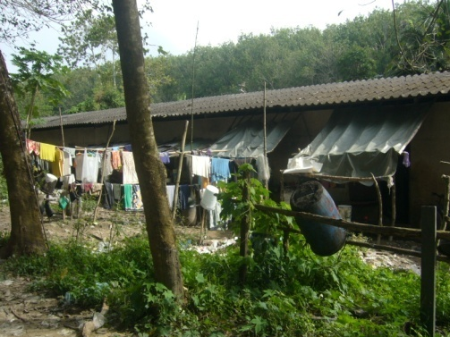
Background & Objectives
To gain an understanding of how to best formulate a communication strategy with the aim to reducing the risk of a potential outbreak of ILIs

Slide 13
Background
Thailand is considered a low impact country when it comes to influenza-like illnesses (ILIs) such as malaria, dengue and pandemic influenza. However, in border areas, ILIs can flare up due to influx of migrants who may be less aware of symptoms and where to seek appropriate care. Registration status and access to information through media are also potential barriers facing migrants.
Phuket has been identified as a priority area for Malaria elimination. As a major tourist destination, Phuket attracts a lot of migrants workers from Burma. Apart from working in the tourism industry, many work in the construction industry as laborers for the many developments around the island. Fishing and rubber tapping are labour intensive industries that also attract large pools of migrants.
In the latter three industries a large proportion of migrants are unregistered and means they don’t have a healthcare card providing them with access to healthcare. This in turn leaves them vulnerable should they contract any type of ILI. Qualitative research by the Kenan Institute Asia has also indicated that migrants have lower awareness about ILIs and how to protect oneself.
As part of USAID Client Associate Award, AED has a mandate to help reducing outbreaks of ILIs in the Greater Mekong Sub region (GMS) countries. As part of this initiative, AED is looking to various behavioral change communication activities in Phuket. A baseline KAP study is therefore needed to understand the level of awareness and behavioral compliance amongst different target audience groups.
Rapid Asia was commissioned to carry out the project. In the initial stages of the project, Rapid Asia has been working closely with a number of stakeholder organizations to ensure that lessons learned in the past were incorporated into the study. They included Kenan Institute, Malaria Unit in Phuket, WorldVision and the Malaria Consortium.

Slide 14
Desk Research
Initial desk research was carried out looking at migrants, health issues and communication in particular. A number of research papers and articles based on past research were reviewed covering countries both in Africa and Asia. In general it was found that migrants may behave differently to local communities when it comes to health issues.
First of all, migrants can be expected to face access barriers to healthcare. Many times their work location can be far away from proper health facilities. If they are not registered they may not have legal access to health care and visiting a clinic may carry some risk of being caught by the police.
Another potential barrier is language, which means that they can have difficulty communicating with healthcare staff. This sometimes prevents them from visiting a clinic or hospital altogether. Not speaking the local language also means that access to health related information is limited.
In contrast to local communities, migrants may place more trust in health related information from relatives and friends as opposed to formal health institutions. A large proportion of migrants are therefore dependent on information from their immediate family and friends. Their employer and work colleagues is another potential source. Hence, it is important to take word of mouth into account as an important information channels when looking at communication impact.
Because many migrants are low skill workers their level of education may be relatively low and means they may have limited understanding about how to protect themselves from disease. This increases their vulnerability and the chance for further transmission is larger as well.
All in all, it is expected that communication strategies aimed at migrants would need to be somewhat different compared to the local community. This relates to both the messages used as well as the channels of communication.

Slide 15
Research Objectives
The overall objective is to gain an understanding of how to best formulate a communication strategy with the aim to reducing the risk of a potential outbreak of ILIs. Whilst certainly malaria is a key focal point for the study, other ILIs such as dengue and pandemic influenza (i.e. H5N1 and H1N1) are also covered. In order to do that effectively, AED is interested to look at the following more specific objectives.
To measure the level of knowledge beneficiaries have about common ILIs with focus on symptoms, transmission routes and actions to take in order to block transmission
To uncover the extent to which beneficiaries engage in preventative behavior and in particular how they are likely to act should an infection occur.
To identify potential barriers to seek appropriate care.
To determine whether health seeking behavior is different for children under 5 years.
To determine media penetration and usage and information sources most relied upon for health related information.
To gain an insight into mobile phone usage and the potential for using mobile phones as a channel for health communication.
To profile different target audience groups based on their level of risk exposure.
To map and profile the different migrant camps included in this study.
With the help of this information, AED will be able to devise a suitable communication strategy using the most effective media and messages for the right target audience.

Slide 16
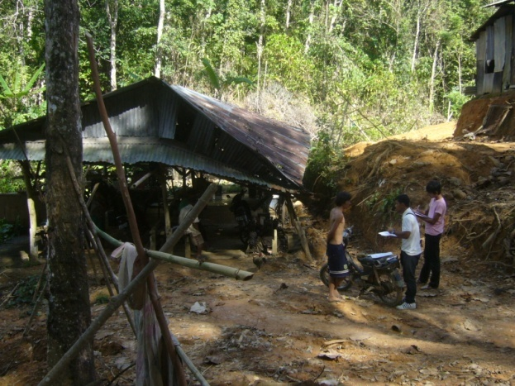
Methodology
Selection of a broad set of migrant camps across industry and malaria transmission risk zones together with neighbouring Thai communities

Slide 17
Target Groups
This study has two broad target groups:
Local Thai communities
Within the Thai community, the target group was households from the lower socioeconomic classes including those with a monthly household income of around 15,000 Baht (USD 500) or less. These are the more vulnerable segments in the community. In each household a household decision maker for health protection issues was targeted for interview.
Burmese Migrants (including both registered and non-registered migrants)
Within the migrant group, all respondents were selected at random within pre-determined camps based on a listing prepared by the Malaria Unit in Phuket. However, soft quotas were used to ensure a mixture of Burmese and Mon migrants. Because these two groups don’t always get along, it was suspected that one or the other would be more dominant in any one camp, and hence, no fixed quotas were set for this reason. Camp locations included construction sites, fishing villages and rubber tapper camps.
It was expected that most migrants in camps would not be able to speak Thai very well and for this reason Burmese and Mon speaking interviewers were employed. These interviewers were recruited in Phuket with assistance from WorldVision. All Burmese and Mon interviewers were trained and managed by qualified field supervisors from Bangkok.
Unregistered migrants were also included in the survey. Because identifying them as unregistered migrants was a delicate issue, this question was not asked directly. Instead, they were asked whether or not they had a current ‘Hospital Card’ or ‘Health Care Card’. Since registered migrants are provided with a health care card, this was a far less sensitive way to determine their status. As to not raise any suspicion at the beginning of the survey, this question was posted right at the end and meant that it was not possible to set fixed quotas on registered and unregistered migrants.

Slide 18
Sample Design
Because this study focuses on health seeking behaviour amongst vulnerable groups, the focus was on selecting migrants living in camps. This was based on previous, qualitative research carried out by the Kenan Institute and the Malaria Unit in Phuket who had already made a detailed mapping of most migrant camps in Phuket.
When selecting a representative sample, the idea is to have a good spread across the sample population. In the case of this study, two factors were used to help achieve this end.
First, industry of engagement. Migrants working in construction, fishing and rubber tapping are not just found in different locations but their risk exposure is also very different. A rubber tapper working in the forest, for example, are faced with far greater risks of contracting malaria compared to a migrant working in a fishing village near the beach.
Secondly, malaria transmission risk zone. The Malaria Unit in Phuket has classified camps into high and Moderate risk groups depending on their location and exposure to different vectors. Additional camps, classified as being in a low risk zone, were also identified. The risk factor was seen as important because it helped to ensure that vulnerable groups were included. Having said that, a high risk zone for malaria may not be a high risk zone for other ILIs, and hence, having a spread across different malaria risk zones were seen as another good way of spreading the sample.
The Thai communities were selected in the vicinity of each camp selected. This was done to insure that the geographical spread of the two samples were similar and that both groups were selected in similar risk zones. The Thai sample serves as a form of a control group against the more vulnerable migrant communities. The distribution of locations selected are shown in the table below.
Malaria Transmission Risk | Migrant Rubber Tapping | Migrant Fishing | Migrant Construction | Thai Community
High | 2 | 1 | 2 | 5
Moderate | 2 | 1 | 3 | 6
Low | 1 | 1 | 2 | 4

Slide 19
Sampling and Sample Size
Sampling was carried out through random selection of households within the pre-selected migrant camps and Thai communities followed by the Kish Grid method for random selection of an adult within the household.
Fieldwork was carried out from 11 October until 16 November.
All interviews were carried out face to face.
The final sample distribution is shown in the table below. No weighting has been applied as there is no record of the size or distribution of the migrant population.
Malaria Transmission Risk | Migrant Rubber Tapping (n) | Migrant Fishing (n) | Migrant Construction (n) | Thai Community (n) | Total (n)
High | 39 | 10 | 100 | 200 | 349
Moderate | 50 | 45 | 50 | 100 | 245
Low | 11 | 45 | 50 | 100 | 206
Total | 100 | 100 | 200 | 400 | 800

Slide 20
Migrant Camp Distribution
The 15 migrant camps included were selected to obtain a good spread across industry as well as risk zone for malaria transmission. Locations were identified in cooperation with the Malaria Unit and Kenan Institute. A good spread across both Burmese and Mon migrants was achieved.
No. | Camp | Risk Zone | Industry | Burmese | Mon | Total
1 | Klong Pak Bang | High | Fishing | 10 | 0 | 10
2 | Koh Sirey | Mod | Fishing | 20 | 25 | 45
3 | Sapan Pramong / Sang Arun Pier | Low | Fishing | 36 | 9 | 45
4 | Nara Project | High | Construction | 55 | 21 | 76
5 | Nai Somsak | High | Construction | 8 | 16 | 24
6 | Koh Kaew / Behind int’l school | Mod | Construction | 8 | 7 | 15
7 | Karon Temple | Mod | Construction | 25 | 2 | 27
8 | Pra Yai Temple | Mod | Construction | 6 | 2 | 8
9 | Soi Mau Khoa | Low | Construction | 10 | 11 | 21
10 | Para | Low | Construction | 6 | 23 | 29
11 | Khao Pae Aw | High | Rubber Tapping | 19 | 13 | 32
12 | Khoa Bangkoo | High | Rubber Tapping | 7 | 0 | 7
13 | Bang Thao | Mod | Rubber Tapping | 2 | 19 | 21
14 | Nam Tok Ton Sai | Mod | Rubber Tapping | 16 | 13 | 29
15 | Luang Pu Supa Temple | Low | Rubber Tapping | 1 | 10 | 11
 | Total |  |  | 229 | 171 | 400

Slide 21
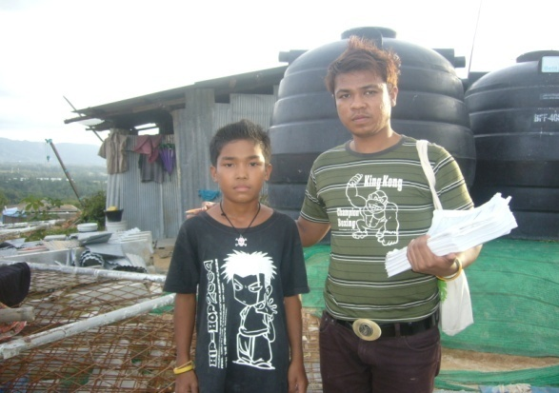
Key Segment Profiles
Migrants and Thai segments as well as migrant sub-segments

Slide 22
Respondent Segments
Thai Origin
Migrant Origin
Migrant Status
Most of the Thais interviewed were local Thais who grew up in Phuket but many have also moved in from other provinces. Migrants are split nearly 50/50 between Burmese and Mon and three our of four migrants interviewed were registered.
Base: All respondents (Thai n=400, Migrants n=400)

Slide 23
Migrant vs. Thai Profile
Profile | Migrants n=400 (%) | Thai n=400 (%)
Sex
Males | 50 | 50
Females | 50 | 50
Age
14-24 | 28 | 18
25-34 | 46 | 21
35-49 | 23 | 41
50 or older | 3 | 20
Education
Elementary school not complete | 29 | 5
Elementary school | 27 | 34
Junior high school | 25 | 20
Senior high school | 17 | 19
Diploma, University or higher | 2 | 22
Work status
Studying | - | 8
Employed | 86 | 42
Home duties | 13 | 17
Unemployed looking for work | 1 | 4
Self employed or other | - | 29
Income (SES)
35,001+ (ABC+) | - | 13
24,000-35,000 (C) | >1 | 13
18,000-24,000 (C-) | 3 | 13
7,500-18,000 (D) | 40 | 54
7,500 or less (E) | 57 | 7
As can be seen, there is a vast difference between migrants living in camps and Thais. Migrants are much younger and most are poorly educated. In terms of financial means they are far worse off with nearly all of them found in the lowest socioeconomic segments of D and E.

Slide 24
Migrant vs. Thai Profile
Profile | Migrants n=400 (%) | Thai n=400 (%)
Marital status
Married | 63 | 70
Household size | # | #
Avg. number of people living in the household | 2.1 | 3.5
Children
Have children under 5 years | 19 | 27
Thai language proficiency
Speak | 68 | 100
Read | 2 | 100
Write | 1 | 100
Burmese language proficiency
Speak | 96 | -
Read | 88 | -
Write | 86 | -
Mon language proficiency
Speak | 53 | -
Read | 21 | -
Write | 19 | -
Illiterate
Speak none of the three | - | -
Read none | 7 | -
Write none | 10 | -
As expected the migrants have smaller households but over half are married and one in five have children under 5 years.
Two out of three migrants can speak a bit of Thai but almost none of them can read and write Thai. Whilst the vast majority can speak Burmese some 7-10 percent are illiterate and are not able to read or write in any of the three languages.

Slide 25
Registered vs. Unregistered Migrant Profile
Profile | Registered n=297 (%) | Unregistered n=103 (%)
Sex
Males | 49 | 52
Females | 51 | 48
Age
14-24 | 25 | 38
25-34 | 47 | 44
35-49 | 25 | 18
50 or older | 4 | -
Education
Elementary school not complete | 31 | 22
Elementary school | 26 | 31
Junior high school | 24 | 27
Senior high school | 18 | 16
Diploma, University or higher | 1 | 4
Work status
Studying | - | -
Employed | 84 | 93
Home duties | 15 | 7
Unemployed looking for work | 1 | -
Self employed or other | - | -
Income (SES)
35,001+ (ABC+) | - | -
24,000-35,000 (C) | - | 1
18,000-24,000 (C-) | 4 | 2
7,500-18,000 (D) | 43 | 29
7,500 or less (E) | 53 | 68
The unregistered migrants tend to be a bit younger still and are on average even worse off economically with two thirds being found in the lowest socioeconomic segment E.

Slide 26
Registered vs. Unregistered Migrant Profile
Profile | Registered n=297 (%) | Unregistered n=103 (%)
Marital status
Married | 67 | 52
Household size | # | #
Avg. number of people living in the household | 2.2 | 1.9
Children
Have children under 5 years | 23 | 8
Thai language proficiency
Speak | 72 | 53
Read | 3 | -
Write | 1 | -
Burmese language proficiency
Speak | 96 | 97
Read | 86 | 92
Write | 84 | 89
Mon language proficiency
Speak | 51 | 36
Read | 23 | 18
Write | 21 | 15
Illiterate
Speak none of the three | - | -
Read no language | 8 | 2
Write no language | 10 | 7
Ethnicity
Burmese | 53 | 68
Mon | 47 | 32
The major difference between registered and unregistered migrants is that those who are registered tend to live in larger households. They are more likely to be married and to have young children. However, in terms of language proficiency there is no major difference. The majority of the unregistered migrants are Burmese.
It should be noted that unregistered migrants were fairly evenly spread across the camps both in terms of industry and malaria transmission risk zone.

Slide 27
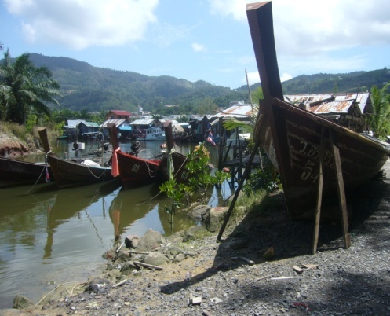
Knowledge About Influenza Like Illnesses
Symptoms, transmission routes and how to block transmission in relation to malaria, dengue and avian influenza.

Slide 28
Knowledge of Malaria
Thai
Migrants
80% for Low malaria transmission risk zone
The vast majority of migrants are aware of malaria and amongst the Thai population it is 100 percent. Awareness across different migrant groups did not differ significantly and shows that Malaria is a disease that people in general know something about. The only group found with a somewhat lower score were migrants located in low risk malaria zones. This could be explained by the Malaria Unit having done a lot of activities in camps with higher risk.
Base: All respondents (Thai n=400, Migrants n=400)

Slide 29
Malaria Symptoms Identified from show card pictures
Correct recognition of high fever and cold shivers is relatively high, especially amongst the Thai population. For other malaria symptoms, such as sweating, there is a recognition gap, especially amongst the migrants. Symptoms which are more relevant for other ILIs are associated with malaria by many people and again, a larger proportion of the migrants have incorrect knowledge here.
Base: Those aware of malaria (Thai n=398, Migrants n=352)

Slide 30
Malaria Transmission Routes Identified from show card pictures
The transmission route for malaria is via night time mosquitoes. It is interesting to note that migrants have better knowledge about this compared to the Thais. Both groups however, have large proportions of people who are confused on this issue, thinking that day time mosquitoes is a possible vector. Some migrants also recognize other, incorrect transmission routes such as water and infected people.
Base: Those aware of malaria (Thai n=398, Migrants n=352)

Slide 31
Association With Day Time Mosquitoes Proportion who get it wrong
Thai
Migrants
Migrant Risk Group | %
Rubber Tappers | 55
Moderate malaria transmission Risk Zones | 53
Aged 35-49 | 54
For the Thai population the incorrect association between malaria and daytime mosquitoes was strongly associated with current main activity. Those studying has better knowledge than those unemployed or engaged with home duties. Within the migrant population the results were more even but it is interesting to note that rubber tappers, who live in the forests and are at most risk, are less educated on the issue.
Base: Those aware of malaria (Thai n=398, Migrants n=352)

Slide 32
Blocking Malaria Transmission Identified from show card pictures
Whilst the association between malaria and night time mosquitoes is not clear, people are aware that mosquito nets can block transmission. In this area migrants appear to have better knowledge than the Thais. For the migrants, however, the incorrect association to other infected people and food is still there.
Base: Those aware of malaria (Thai n=398, Migrants n=352)

Slide 33
Knowledge of Dengue
Thai
Migrants
73% for Mon
83% who are not aware of Malaria are also not aware of Dengue
Thais are 100 percent aware of dengue but one in five migrants are not aware. There were no real significant differences between migrant sub groups but fewer Mon were found to be aware about dengue with 73 percent. If a migrant is not aware of malaria then it is very likely they are not aware of dengue as well.
Base: All respondents (Thai n=400, Migrants n=400)

Slide 34
Dengue Symptoms Identified from show card pictures
Apart from fever and cols shivers, Thais are aware of red spots or rashes. Migrants, on the other hand have higher awareness about joint pain, red eyes and prolonged tiredness. Overall it would appear that a Thais have a better chance of recognizing the symptoms of dengue compared to migrants.
Base: Those aware of dengue (Thai n=400, Migrants n=319)

Slide 35
Dengue Transmission Routes Identified from show card pictures
The transmission routes for dengue, through day time mosquitoes, is less confused compared to malaria. The majority of both Thais and migrants get it right but there are still large proportions in both groups who associate transmission with night time mosquitoes.
Base: Those aware of dengue (Thai n=400, Migrants n=319)

Slide 36
Day/Night Time Mosquitoes Association Proportion who get it right
Thai
Migrants
Dengue
Dengue
 | Wrong | Correct
Wrong | 20% | 34%
Correct | 1% | 45%
 | Wrong | Correct
Wrong | 18% | 18%
Correct | 16% | 48%
Malaria
Malaria
To verify just how confused people are about day vs. night time mosquitoes and the respective diseases, a comparison was made to see what proportion get it right for both and what proportion get it wrong. The results show that less than half the Thai and migrant population get both correct. Around one in five people in both populations believe the exact opposite. A further one third will have one or the other incorrect.
Base: Those aware of dengue and malaria
(Thai n=398, Migrants n=311)

Slide 37
Blocking Dengue Transmission Identified from show card pictures
Again, mosquito nets tops the list together with window screens and repellant. However, an increasing number of people are now also mentioning other ways to block transmission such as residual spraying, not leaving empty containers and covering water storage containers. The incorrect association to infected people and food remains with migrants.
Base: Those aware of dengue (Thai n=400, Migrants n=319)

Slide 38
Knowledge of H1N5 / H1N1
Thai
Migrants
58% for Low malaria transmission risk zone
13 out of the 15 camps have chickens and/or ducks running around freely
Knowledge of H1N5 or H1N1 is also high amongst the Thais with near 100 percent being aware of this type of disease. For migrants awareness is much lower with only two in three migrants being aware. Again, awareness was found to be lower still amongst migrants in camps in low risk malaria transmission zones.
Base: All respondents (Thai n=400, Migrants n=400)

Slide 39
H1N5 / H1N1 Symptoms Identified from show card pictures
High fever is about the only symptom with relatively high awareness although significantly lower for migrants. For other relevant symptoms there is a significant gap in knowledge and may not be surprising given these influenza diseases are relatively new compared to malaria and dengue.
Base: Those aware of H1N5 / H1N1 (Thai n=397, Migrants n=265)

Slide 40
H1N5 / H1N1 Transmission Routes Identified from show card pictures
What people do know is that transmission comes from chickens and ducks and to some extent infected people. Migrants are at a disadvantage here with significantly less knowledge compared to Thai.
Base: Those aware of H1N5 / H1N1 (Thai n=397, Migrants n=265)

Slide 41
Blocking H1N5 / H1N1 Transmission Identified from show card pictures
Unlike dengue and malaria, these types of influenzas are clearly distinct when it comes to associated transmission routes. Whilst the knowledge amongst migrants is lower compared to Thai, a similar and rather strong distinction between the different diseases can be seen.
Base: Those aware of H1N5 / H1N1 (Thai n=397, Migrants n=265)

Slide 42
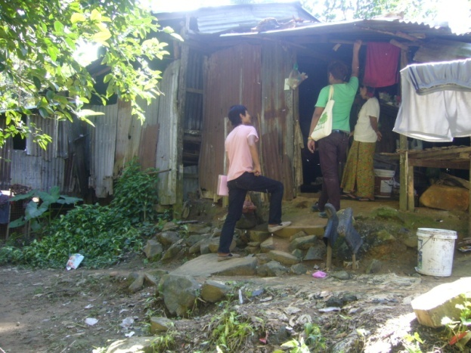
Preventative Behaviour
To what extent are Thai and migrants protecting themselves from contracting ILIs

Slide 43
Use of Window Screens Observation
Thai
Migrants
Nearly half the Thai population do not use window screens but those who do will in most cases have them on all windows. The migrants are at a disadvantage here due to camp conditions and just about all of them have no type of screen protection against mosquitoes unless they use a net.
Base: All respondents (Thai n=400, Migrants n=400)

Slide 44
Littering of Water Collecting Containers Observation
Thai Households
Migrant Households
Migrant Camps
Around Thai households it is relatively clean and there are very few instances when you see large amounts of water collecting containers lying around. The same applies to migrant households. However, from observation around the migrant communities there were often instances where you could find large amounts of rubbish lying around elsewhere in the community such as a public garbage dump.
Base: All respondents (Thai n=400, Migrants n=400)

Slide 45
Mosquito Net, Repellent and Coil Observation
Observed in home
Condition of mosquito net
Fewer (77%) unregistered migrants have nets
Indeed most migrants have mosquito nets and nine out of ten are in good condition with no holes in them. Many also use mosquito coil but repellant is used to a lesser extent. Fewer Thais use mosquito nets as many are using window screens. It should be noted that using nets did not differentiate between those aware of malaria or not aware, suggesting some use nets just to avoid mosquitoes bites.
Base: All respondents (Thai n=400, Migrants n=400)
Base: Those with mosquito nets (Thai n=98, Migrants n=338)

Slide 46
Preventative Practice for ILIs Thai
Extent of practice
Reason for NOT always using mosquito nets
It is evident that Thai communities don’t actively protect themselves against mosquitoes and in most cases this is due to having their windows fitted with mosquito nets. Hence, the main reason for not using them is that they don’t feel it is needed. It seems coughing and sneezing in ones elbow is not something that comes natural to people, nobody practice this.
Base: All Thai respondents (n=400)
Base: Those not always using mosquito nets (n=319)

Slide 47
Preventative Practice for ILIs Migrants
Extent of practice
Reason for NOT always using mosquito nets
Fewer (74%) unregistered migrants always use a net
One in five migrants don’t always use a mosquito net and the main reason is that it is too hot. Unlike the Thai communities, some camps don’t have electricity and so there is no opportunity to use a fan. However, using repellant when working outside is just the opposite with only one in five migrants practicing.
Base: All Migrant respondents (n=400)
Base: Those not always using mosquito nets (n=80)

Slide 48
Willing to Give a Blood Sample to a HCW Thai vs. Migrants
Thai
Migrants
The vast majority of both Thais and migrants are willing to participate in a blood test if asked by a HCW. Some Thais may hesitate and would only participate if they thought they were ill.
Base: All respondents (Thai n=400, Migrants n=400)

Slide 49
At Risk of Exposure to Malaria Vectors
Thai
Migrants
Taking into account the combination of either having screen on all windows or using mosquito nets, it was found that many Thais who don’t have window screens do use mosquito nets to a greater extent. However, many use neither and results in many Thais being at risk of exposing themselves to malaria vectors. Because Thai communities are in the vicinity of the migrant camps, the risk of exposure may be greater but vectors of course are more likely to originate in the migrant camps.
Base: All respondents (Thai n=400, Migrants n=400)

Slide 50
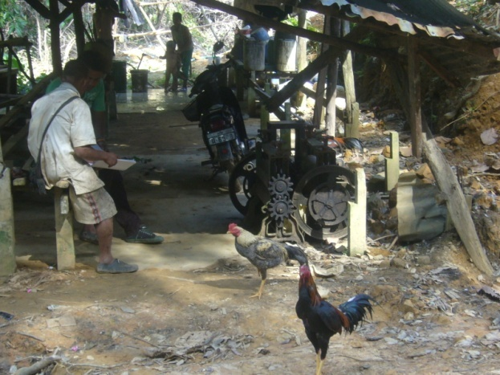
Health Seeking Behaviour
What Thai and Migrants do when they become ill with influenza like symptoms such as high fever and cold shivers

Slide 51
Who Would You Ask for Advice? Symptom: High fever and cold shivers
High fever and cold shivers were used as a hypothetical scenario to obtain information on health seeking behavior. The majority of both Thais and migrants would seek advice from a doctor should they come down with high fever and cold shivers. Migrants are also likely to seek advice from family and friends and may seek advice from their employer as well.
Base: All respondents (Thai n=400, Migrants n=400)

Slide 52
Where Would You Go For Treatment? Symptom: High fever and cold shivers
Reason for NOT going to hospital or clinic
 | Thai n=9* (%) | Migrants n=14* (%)
Language | 0 | 71
No Health Card | 0 | 29
Too expensive | 22 | 43
Don’t trust | 22 | 14
Too far away | 11 | 29
Can’t do better | 11 | 7
Waiting too long | 44 | 14
Other | 11 | 21
*Small base
The vast majority would seek treatment at a hospital or clinic. In Phuket there are plenty of small clinics around and particularly unregistered migrants may seek treatment there if they can afford it. Government hospitals are cheaper and often preferred by migrants but the employer may have to bribe police to enable transportation should the worker not be registered. Since two thirds of migrants can speak some Thai as well as English, language was not found to be a major barrier.
Base: All respondents (Thai n=400, Migrants n=400)
Base: Those not going to a hospital or clinic

Slide 53
Ever bought Medicine? Symptom: High fever and cold shivers
Type of medicine and location
Thai
 | Thai n=277 (%)
Type of medicine
Fever reducing | 99
Antibiotics | 11
Herbal | 1
Other | 0
Location
Pharmacy | 51
Local drug store | 48
Hospital / Clinic | 1
Other | 0
In response to high fever and cold shivers, two thirds of Thais have bought fever reducing medicine in the past. Some also buy antibiotics. They will purchase the medicine either at the pharmacy or local drug store.
Base: All Thai respondents (n=400)
Base: Those who bought medicine

Slide 54
Ever bought Medicine? Symptom: High fever and cold shivers
Type of medicine and location
Migrants
 | Migrants n=222 (%)
Type of medicine
Fever reducing | 97
Antibiotics | 11
Herbal | 6
Other | 1
Location
Pharmacy | 4
Local drug store | 92
Govn’t health center | 4
Other | 0
Just over half of the migrants have purchased medicine for high fever and cold shivers and fever reducing medicine is most common. Migrants prefer to go to the local drug store as it is cheaper and usually closer at hand.
Base: All Migrant respondents (n=400)
Base: Those who bought medicine

Slide 55
Health Seeking Behaviour After Treatment At hospital or clinic
If the hospital or clinic prescribe medicine, both Thais and migrants will take it as prescribed but some Thais may stop taking the medicine should the symptoms disappear. Both groups will go back for check up but some Thais may only do it if they are told. This indicates that treatment is likely to be followed through for most patients who are admitted for ILIs.
Base: Those who would seek treatment at a hospital or clinic
(Thai n=391 , Migrants n=386)

Slide 56
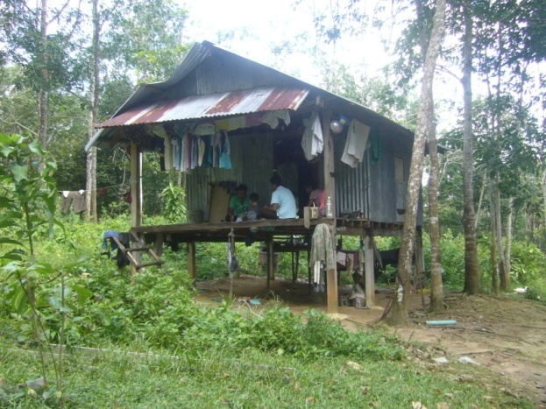
Health Seeking Behaviour - Children 0-5 years
What Thais and Migrants believe they will do if their child becomes ill

Slide 57
Have Children under 5 years
Thai
Migrants
8% for those Unregistered
One in five migrant households have a child under five years. As expected, this proportion is less compared to the local Thai households where over a quarter have a child under 5 years. The incidence of children is smaller for unregistered migrants who are on average younger a fewer are married.
Base: All respondents (Thai n=400, Migrants n=400)

Slide 58
Would Go to Hospital or Clinic Symptom in Child: High fever and cold shivers
Thai
Migrants
Health seeking behavior is stronger for children and nearly all Thais and migrants would seek care in a hospital or clinic should their child become ill.
Base: Those with children under 5 years
(Thai n=106 , Migrants n=77)

Slide 59
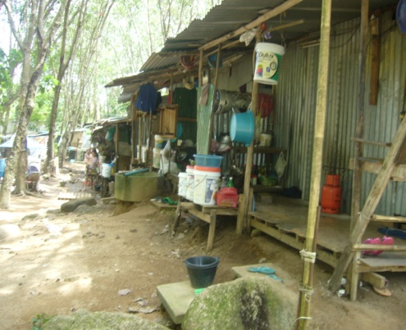
Media Penetration and Usage
Mainstream media and mobile phones

Slide 60
Media Penetration & Consumption
Media in household
Media consumed in past 7 days
Registered 65%
Unregistered 50%
Registered 31%
Unregistered 49%
Registered 34%
Unregistered 50%
There is a distinct difference between migrants and Thais when it comes to media penetration and consumption. One in three migrants, or one in two for unregistered migrants, don’t have access to any media. The only way to communicate to these migrants would be through HCW, word of mouth or through their employer.
Base: All respondents (Thai n=400, Migrants n=400)

Slide 61
Media Consumption
Television
Radio
Television, as expected, is watched at night between 6 and 9 pm. Radio on the other hand can be listened to throughout the day and some listen to the radio through their mobile phone. The general media consumption pattern for Thais and migrants is quite similar.
Base: Those consuming the media in the past 7 days (Thai n=397 / 233 , Migrants n=243 / 26)

Slide 62
Media Consumption Thais only (migrant base too small)
Newspaper
Internet
Newspapers and the Internet are each other’s opposite. Newspapers are mainly read in the morning or before lunch whilst most people access the internet at night after 6pm. Migrants are not shown here due to limited sample size.
Base: Thais consuming the media in the past 7 days (n=228 / 108)

Slide 63
Mobile Phone Penetration
Thai
Migrants
53% for unregistered
Service Provider | n=372 (%)
AIS | 41
DTAC | 52
True Move | 7
Service Provider | n=244 (%)
AIS | 3
DTAC | 97
True Move | 0
Mobile phone penetration is very high amongst the Thai population at 93 percent. It is however, surprisingly high amongst migrants as well and nearly two in three migrants have a connected mobile phone. It is interesting to note that migrants almost exclusively use DTAC. This is a result of DTAC promotion activities, offering reduced call rates between phones within the DTAC network.
Base: All respondents (Thai n=400, Migrants n=400)
Base: Those with mobile phones

Slide 64
Mobile Phone Features Used
Thai
Migrants
82% English*
14% Burmese
4% Thai
100% in Thai
Apart from making and receiving voice calls, people use SMS, Bluetooth and listen to the radio. The usage pattern for migrants is somewhat lower and could be due to cost factors. It is noteworthy that 83 percent of migrants use roman characters when texting. This is due to font limitations on the phones. Only those who purchased their mobile phones from Burma or know how to download fonts can send text in Burmese. However, if they purchased the phone in Thailand the font may not be available. Burma use to be an English colony so some migrants can speak better English than Thai people.
Base: Those with mobile phones (Thai n=372, Migrants n=244)

Slide 65
Mobile Phones With Memory Card Slot Observation
Thai
Migrants
Many, but not all, mobile phones have memory card slots where you can insert a card to upload or save information or files. Recent phone models are more likely to have this feature and this is why a difference can be seen between Thais and migrants. Many migrants are expected to buy second hand handsets and means their phones are likely to be older on average. Still, one third of migrants have a memory card slot on their phone which potentially could be use for communication activities such as disseminating and sharing health messages.
Base: Those with mobile phones (Thai n=372, Migrants n=244)

Slide 66
Media Relied on For Health Information
Thai
Migrants
It is interesting to see the impact achieved by local HCWs. They are relied upon by 69 percent of Thais and 49 percent of migrants. Whilst Thais rely heavily on main stream media (which will broadcast PSAs), migrants are far more reliant on outreach activities as well as talking to friends. This is consistent with the low media penetration amongst migrants. Employers represent a smaller but potentially significant source for migrants and perhaps employers could play a greater role.
Base: All respondents (Thai n=400, Migrants n=400)

Slide 67
Media Exposure by Disease
Thai
Migrants
Media | Malaria n=398 (%) | Dengue n=400 (%) | H1N5/N1 n=397 (%)
TV | 93 | 94 | 98
HCWs | 66 | 66 | 64
Newspaper | 24 | 23 | 31
W-O-M | 23 | 22 | 29
Radio | 12 | 11 | 20
Posters | 2 | 2 | 10
Employer | 0 | 0 | 1
Average no. of media sources | 2.2 | 2.2 | 2.5
Media | Malaria n=352 (%) | Dengue n=319 (%) | H1N5/N1 n=265 (%)
TV | 42 | 39 | 40
HCWs | 49 | 50 | 55
Newspaper | 2 | 3 | 2
W-O-M | 58 | 57 | 56
Radio | 5 | 4 | 4
Posters | 6 | 6 | 6
Employer | 10 | 10 | 15
Average no. of media sources | 1.7 | 1.7 | 1.8
Media exposure for different ILIs follows the source media for health related information very closely. The difference between different ILIs is not hugely different although it appears there may have been a recent push for H1N5/H1N1. Again, the distinction between migrants and Thais can be seen in that migrants rely more heavily on informal media and overall, they have access to fewer media sources.
Base: Those aware of the disease

Slide 68
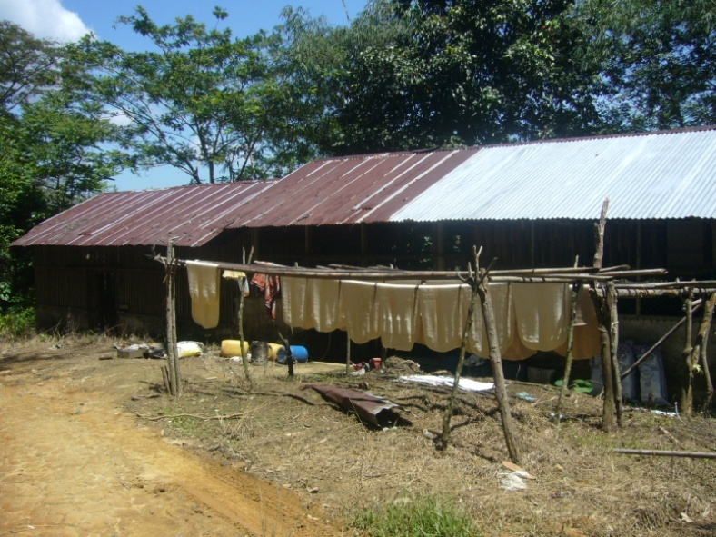
Appendix: Profiles of Migrant Camps
Observational data collected at each migrant camp to identify the extent to which different camps are faced with different risks

Slide 69
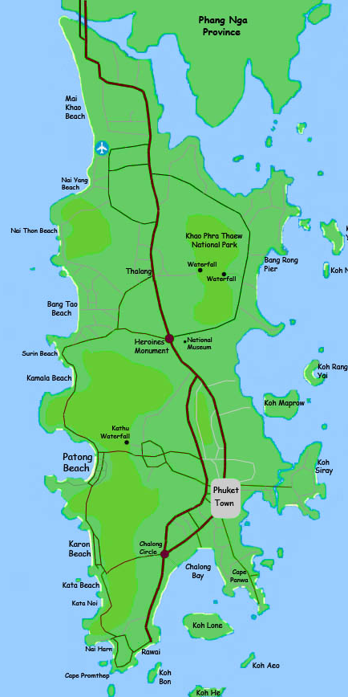
Migrant Camp Locations
9
No. | Camp
1 | Klong Pak Bang
2 | Koh Sirey
3 | Sapan Pramong / Sang Arun Pier
4 | Nara Project
5 | Nai Somsak
6 | Koh Kaew / Behind int’l school
7 | Karon Temple
8 | Pra Yai Temple
9 | Soi Mau Khoa
10 | Para
11 | Khao Pae Aw
12 | Khoa Bangkoo
13 | Bang Thao
14 | Nam Tok Ton Sai
15 | Luang Pu Supa Temple
4
10
14
11
13
12
6
1
2
3
7
8
15
5

Slide 70
Migrant Camp Distribution
The 15 migrant camps included were selected to obtain a good spread across industry as well as risk zone for malaria transmission. Locations were identified in cooperation with the Malaria Unit. A good spread across both Burmese and Mon migrants was achieved.
No. | Camp | Risk Zone | Industry | Burmese | Mon | Total
1 | Klong Pak Bang | High | Fishing | 10 | 0 | 10
2 | Koh Sirey | Mod | Fishing | 20 | 25 | 45
3 | Sapan Pramong / Sang Arun Pier | Low | Fishing | 36 | 9 | 45
4 | Nara Project | High | Construction | 55 | 21 | 76
5 | Nai Somsak | High | Construction | 8 | 16 | 24
6 | Koh Kaew / Behind int’l school | Mod | Construction | 8 | 7 | 15
7 | Karon Temple | Mod | Construction | 25 | 2 | 27
8 | Pra Yai Temple | Mod | Construction | 6 | 2 | 8
9 | Soi Mau Khoa | Low | Construction | 10 | 11 | 21
10 | Para | Low | Construction | 6 | 23 | 29
11 | Khao Pae Aw | High | Rubber Tapping | 19 | 13 | 32
12 | Khoa Bangkoo | High | Rubber Tapping | 7 | 0 | 7
13 | Bang Thao | Mod | Rubber Tapping | 2 | 19 | 21
14 | Nam Tok Ton Sai | Mod | Rubber Tapping | 16 | 13 | 29
15 | Luang Pu Supa Temple | Low | Rubber Tapping | 1 | 10 | 11
 | Total |  |  | 229 | 171 | 400

Slide 71
Traffic Light Scoring
In order to compare the risk level migrants face across different camps, the following traffic light scoring system has been applied.
Community Indicator | Low Risk | Moderate Risk | High Risk
Malaria transmission risk | LOW | MODERATE | HIGH
Facilities | Electricity and Running Water | Electricity or Running Water | None
Media access & Mobile coverage | Mobile coverage, TV and Radio media | Mobile coverage, TV or Radio media | Mobile coverage only
Condition of access road | Sealed Road | Dirt road with 2WD access | Dirt road with 4WD/MC access only
Distance to nearest clinic | 1 km or less | 2 up to 5 km | Over 5 km
H1N5 Bio Security | No Chicken or ducks running around feely | Chicken or ducks running around feely | Chicken and ducks running around feely
Water collection containers | None | Some | Many

Slide 72
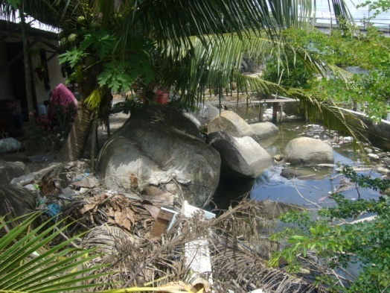
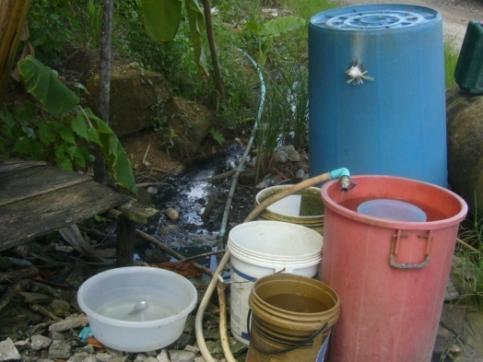
Camp 1: Klong Pak Bang
Community Indicator | Observation | Risk Rating
Population size | 50 | -
Main industries | Fishing | -
Ethnic groups present | Local, Thai, Burmese | -
Malaria risk zone | HIGH
Facilities | Electricity
Media & Mobile | Mobile, TV, Radio
Condition of access road | Dirt Road with 2WD truck access
Distance to nearest clinic | 1 km
H1N5 Bio Security | MODERATE
Water collection containers | Many
GPS coordinates | Latitude: 7.8898 Longitude: 98.2967 | -

Slide 73
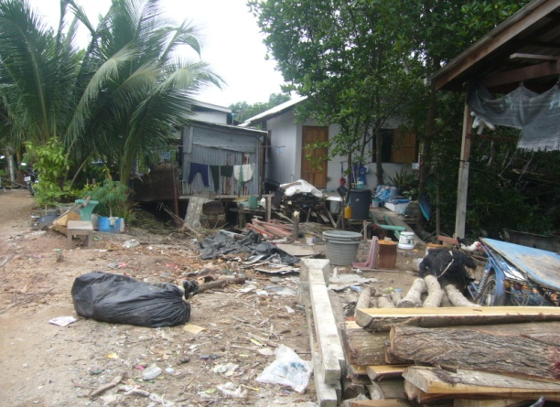
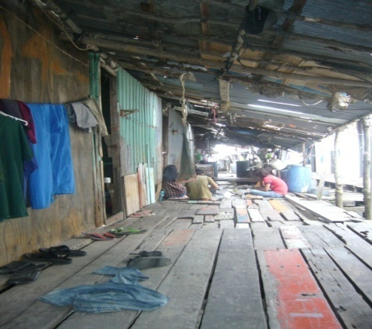
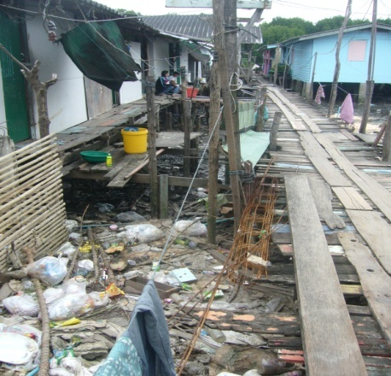
Camp 2: Koh Sirey
Community Indicator | Observation | Risk Rating
Population size | 300 | -
Main industries | Fishing | -
Ethnic groups present | Local, Thai, Burmese, Mon | -
Malaria risk zone | MODERATE
Facilities | Electricity , Running Water
Media & Mobile | Mobile, TV, Radio
Condition of access road | Sealed Road
Distance to nearest clinic | Less than 1 km
H1N5 Bio Security | LOW
Water collection containers | Many
GPS coordinates | Latitude: 7.8821 Longitude: 98.4279 | -

Slide 74
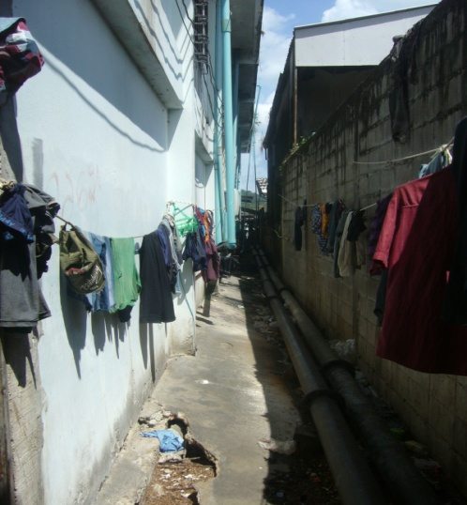
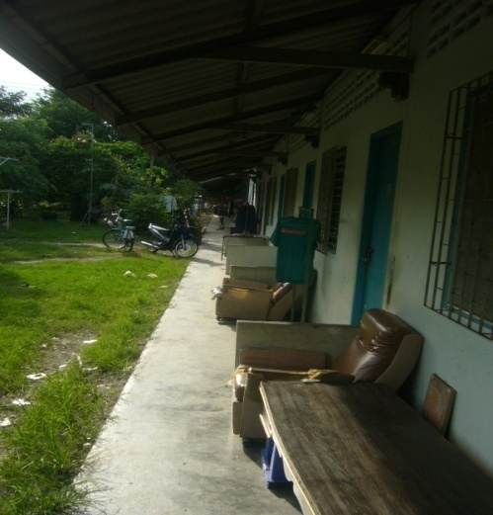
Camp 3: Sapan Pramong / Sang Arun Pier
Community Indicator | Observation | Risk Rating
Population size | 200 | -
Main industries | Fishing | -
Ethnic groups present | Local, Thai, Burmese, Mon | -
Malaria risk zone | LOW
Facilities | Electricity , Running Water
Media & Mobile | Mobile, TV, Radio
Condition of access road | Sealed Road
Distance to nearest clinic | 1 km
H1N5 Bio Security | HIGH
Water collection containers | Some
GPS coordinates | Latitude: 7.8808 Longitude: 98.4160 | -

Slide 75
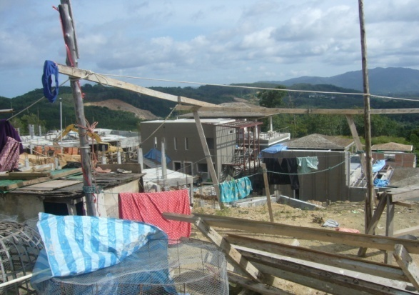
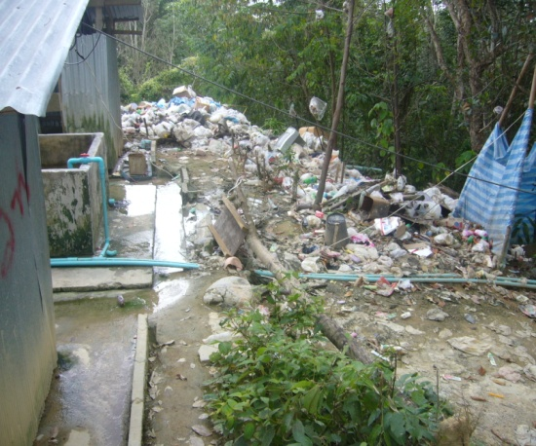
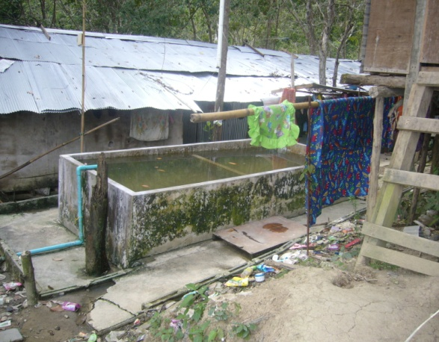
Camp 4: Nara Project
Community Indicator | Observation | Risk Rating
Population size | 400 | -
Main industries | Construction | -
Ethnic groups present | Thai, Burmese, Mon | -
Malaria risk zone | HIGH
Facilities | Electricity
Media & Mobile | Mobile, TV, Radio
Condition of access road | Sealed Road
Distance to nearest clinic | 10 km
H1N5 Bio Security | LOW
Water collection containers | Many
GPS coordinates | Latitude: 8.0294 Longitude: 98.2944 | -

Slide 76
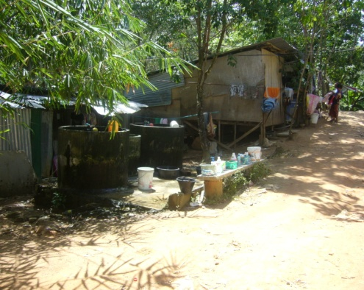
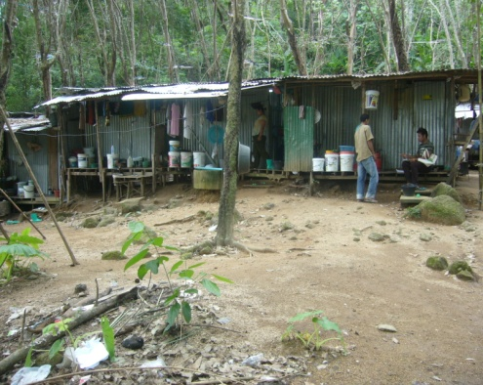
Camp 5: Nai Somsak
Community Indicator | Observation | Risk Rating
Population size | 30 | -
Main industries | Construction | -
Ethnic groups present | Burmese, Mon | -
Malaria risk zone | HIGH
Facilities | Electricity , Running Water
Media & Mobile | Mobile, TV, Radio
Condition of access road | Dirt Road with 2WD truck access
Distance to nearest clinic | 4 km
H1N5 Bio Security | MODERATE
Water collection containers | Some
GPS coordinates | Latitude: 7.7872 Longitude: 98.3165 | -

Slide 77
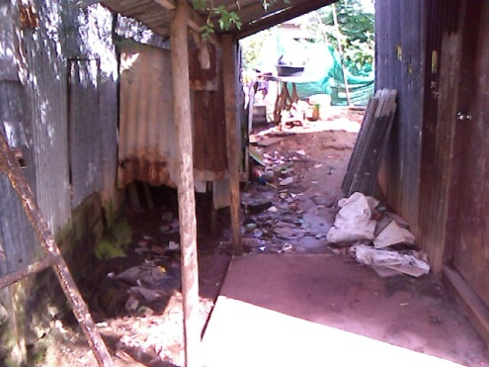
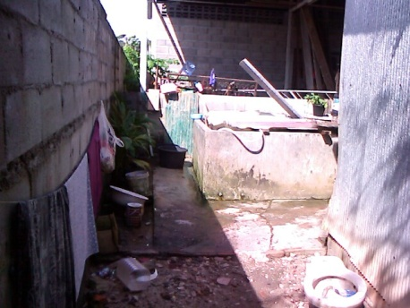
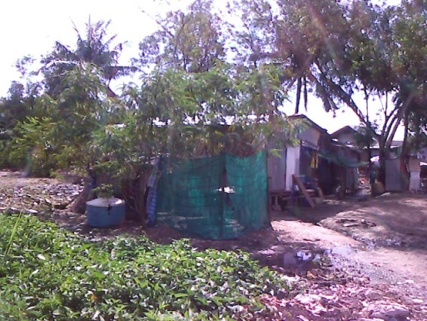
Camp 6: Koh Kaew
Community Indicator | Observation | Risk Rating
Population size | 40 | -
Main industries | Construction | -
Ethnic groups present | Thai, Burmese, Mon | -
Malaria risk zone | MODERATE
Facilities | Electricity
Media & Mobile | Mobile, TV, Radio
Condition of access road | Dirt road with 2WD access
Distance to nearest clinic | 4 km
H1N5 Bio Security | MODERATE
Water collection containers | Many
GPS coordinates | Latitude: 7.9500 Longitude: 98.3707 | -

Slide 78
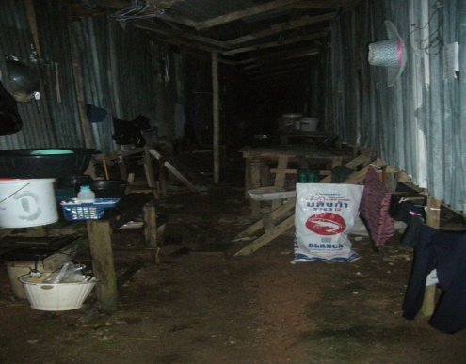
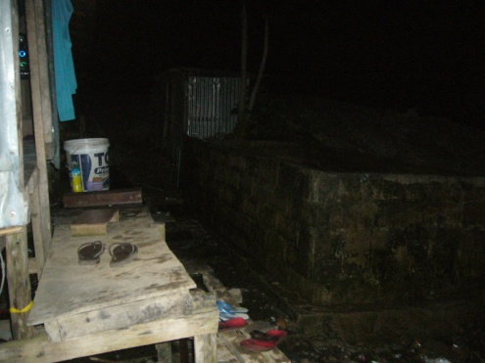
Camp 7: Karon Temple
Community Indicator | Observation | Risk Rating
Population size | 110 | -
Main industries | Construction | -
Ethnic groups present | Thai, Burmese, Mon | -
Malaria risk zone | MODERATE
Facilities | Electricity , Running Water
Media & Mobile | Mobile, TV, Radio
Condition of access road | Sealed road
Distance to nearest clinic | 5 km
H1N5 Bio Security | MODERATE
Water collection containers | Some
GPS coordinates | Latitude: 7.8478 Longitude: 98.2978 | -

Slide 79
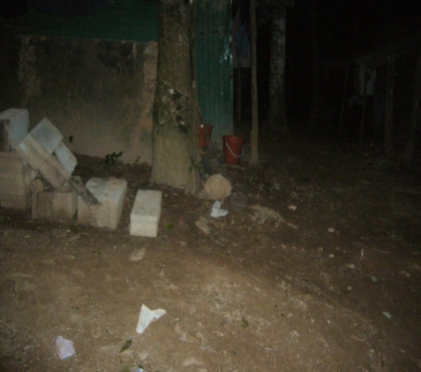
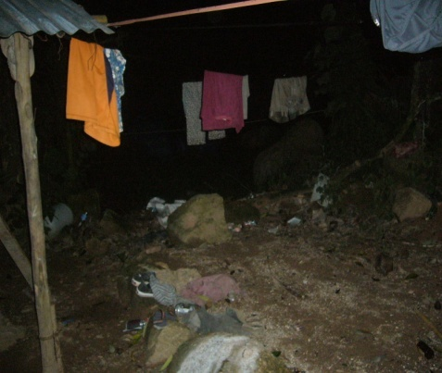
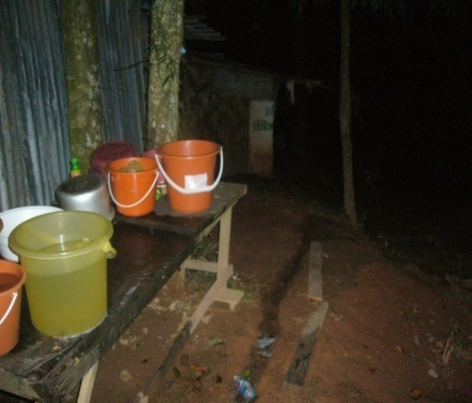
Camp 8: Pra Yai Temple
Community Indicator | Observation | Risk Rating
Population size | 65 | -
Main industries | Construction | -
Ethnic groups present | Burmese, Mon | -
Malaria risk zone | MODERATE
Facilities | None
Media & Mobile | Mobile, TV, Radio
Condition of access road | Sealed road
Distance to nearest clinic | 7 km
H1N5 Bio Security | MODERATE
Water collection containers | Some
GPS coordinates | Latitude: 7.8485 Longitude: 98.3342 | -

Slide 80
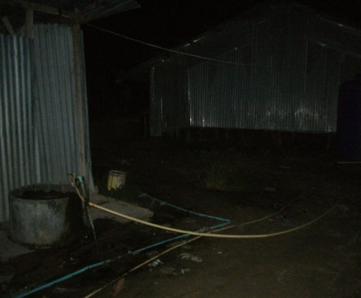
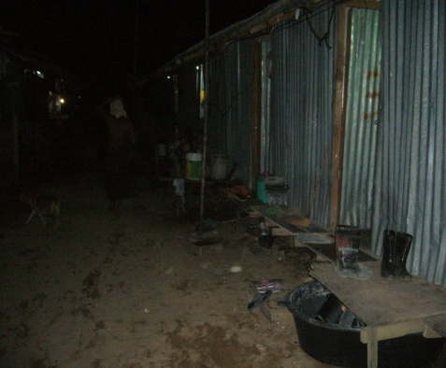
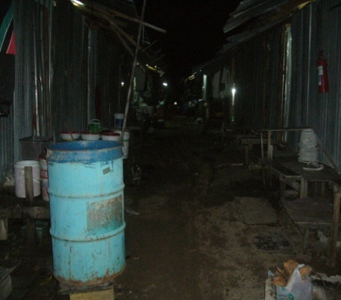
Camp 9: Soi Mau Khoa
Community Indicator | Observation | Risk Rating
Population size | 150 | -
Main industries | Construction | -
Ethnic groups present | Thai, Burmese, Mon | -
Malaria risk zone | LOW
Facilities | Electricity, Running Water
Media & Mobile | Mobile, TV, Radio
Condition of access road | Sealed Road
Distance to nearest clinic | 5 km
H1N5 Bio Security | MODERATE
Water collection containers | Some
GPS coordinates | Latitude: 8.1251 Longitude: 98.3060 | -

Slide 81
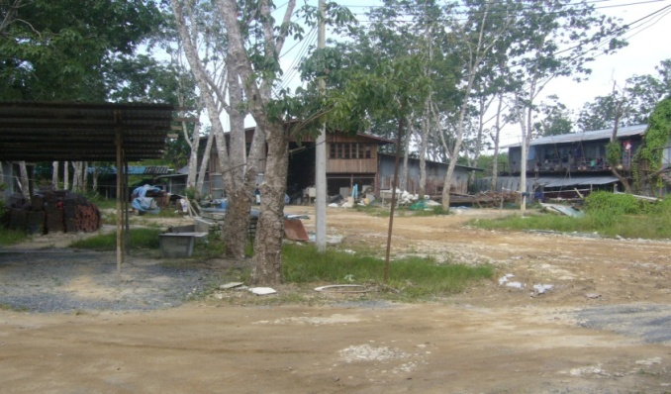
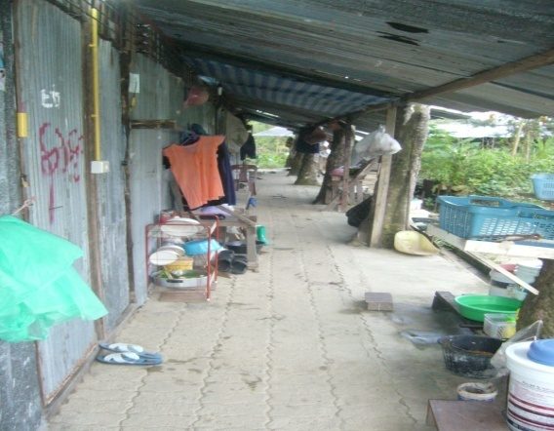
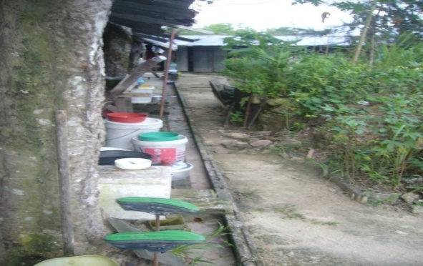
Camp 10: Para
Community Indicator | Observation | Risk Rating
Population size | 80 | -
Main industries | Construction | -
Ethnic groups present | Thai, Burmese, Mon | -
Malaria risk zone | LOW
Facilities | Electricity
Media & Mobile | Mobile, TV, Radio
Condition of access road | Dirt Road with 2WD truck access
Distance to nearest clinic | Less than 1 km
H1N5 Bio Security | MODERATE
Water collection containers | Many
GPS coordinates | Latitude: 8.0781 Longitude: 98.3838 | -

Slide 82
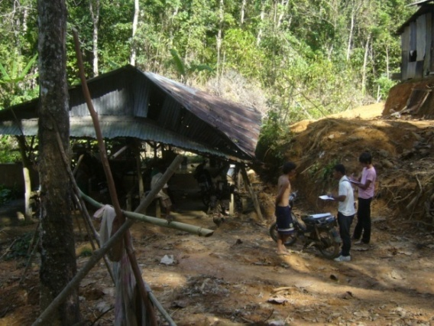
Camp 11: Khao Pae Aw
Community Indicator | Observation | Risk Rating
Population size | 30 | -
Main industries | Construction Rubber Tapping | -
Ethnic groups present | Burmese, Mon | -
Malaria risk zone | HIGH
Facilities | None
Media & Mobile | Mobile, TV, Radio
Condition of access road | Dirt road with 4WD access only
Distance to nearest clinic | 5 km
H1N5 Bio Security | LOW
Water collection containers | Many
GPS coordinates | Latitude: 7.9734 Longitude: 98.3438 | -

Slide 83
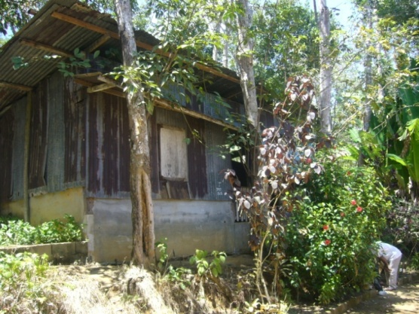
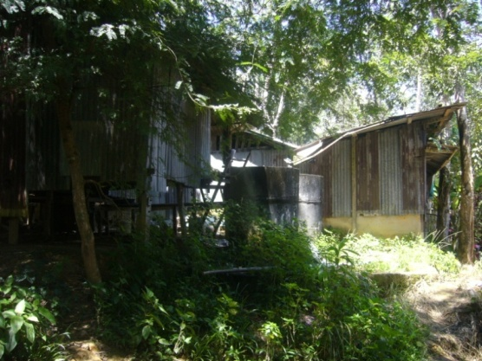
Camp 12: Khao Bangkoo
Community Indicator | Observation | Risk Rating
Population size | 10 | -
Main industries | Rubber Tapping | -
Ethnic groups present | Burmese | -
Malaria risk zone | HIGH
Facilities | None
Media & Mobile | Mobile
Condition of access road | Sealed Road
Distance to nearest clinic | 7 km
H1N5 Bio Security | MODERATE
Water collection containers | Some
GPS coordinates | Latitude: 7.9251 Longitude: 98.3281 | -

Slide 84
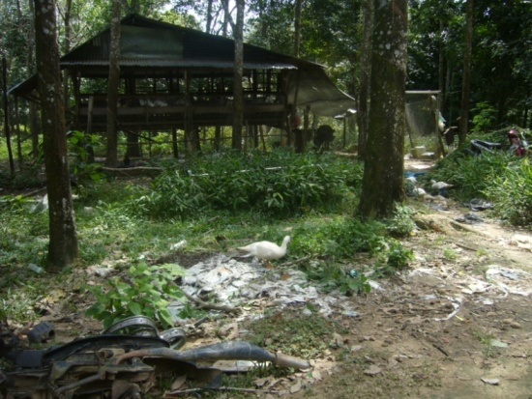
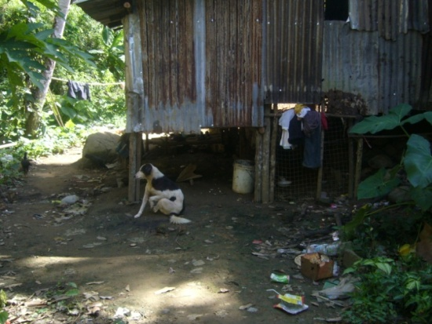
Camp 13: Bang Thao
Community Indicator | Observation | Risk Rating
Population size | 30 | -
Main industries | Rubber Tapping | -
Ethnic groups present | Burmese, Mon | -
Malaria risk zone | MODERATE
Facilities | Electricity
Media & Mobile | Mobile, TV, Radio
Condition of access road | Dirt road with MC access only
Distance to nearest clinic | 3 km
H1N5 Bio Security | MODERATE
Water collection containers | Many
GPS coordinates | Latitude: 7.9803 Longitude: 98.2978 | -

Slide 85
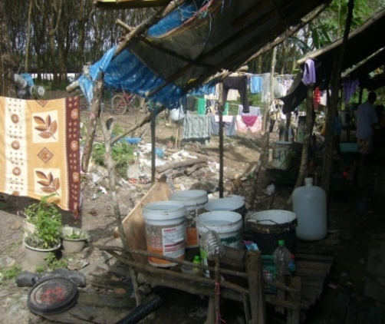
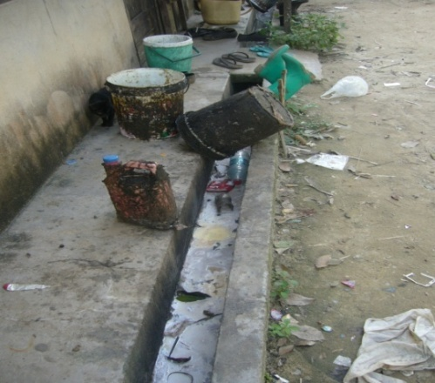
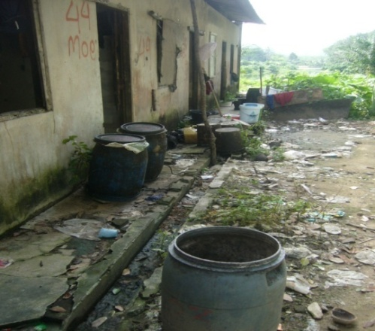
Camp 14: Nam Tok Ton Sai
Community Indicator | Observation | Risk Rating
Population size | 50 | -
Main industries | Rubber Tapping | -
Ethnic groups present | Thai, Burmese, Mon | -
Malaria risk zone | MODERATE
Facilities | Electricity, Running Water
Media & Mobile | Mobile, TV, Radio
Condition of access road | Dirt road with MC access only
Distance to nearest clinic | 5 km
H1N5 Bio Security | MODERATE
Water collection containers | Many
GPS coordinates | Latitude: 8.0354 Longitude: 98.3501 | -

Slide 86
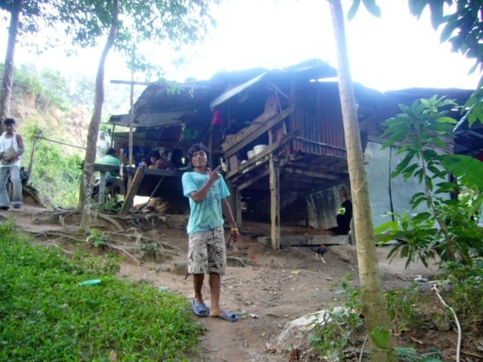
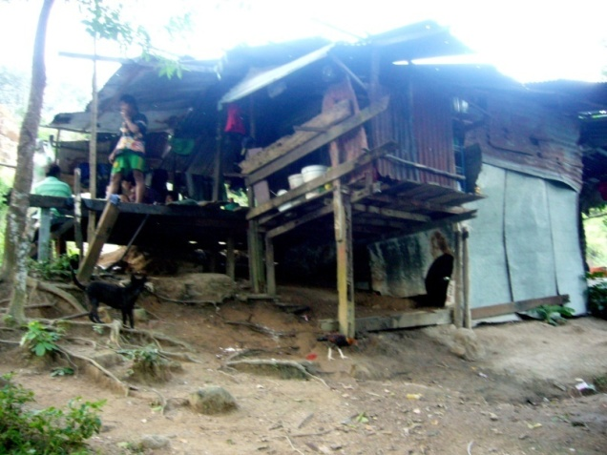
Camp 15: Luang Pu Supa Temple
Community Indicator | Observation | Risk Rating
Population size | 15 | -
Main industries | Rubber Tapping | -
Ethnic groups present | Burmese, Mon | -
Malaria risk zone | LOW
Facilities | Electricity
Media & Mobile | Mobile, TV, Radio
Condition of access road | Dirt road with 4WD access only
Distance to nearest clinic | 8 km
H1N5 Bio Security | HIGH
Water collection containers | Some
GPS coordinates | Latitude: 7.8544 Longitude: 98.3287 | -

Slide 87
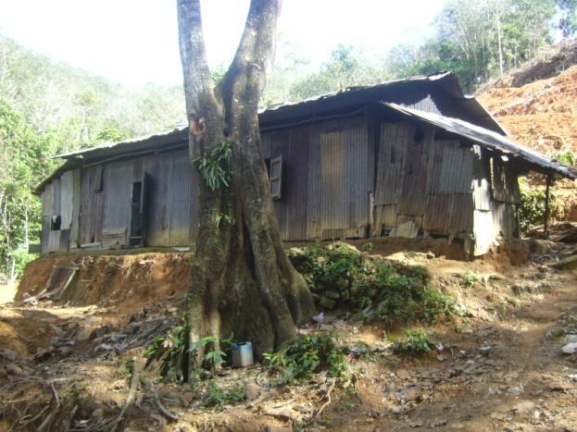
Contact Information
For information about AED and this study, please contact:
Robert Kelly at AED on:
T: +66 2 632 1117
E: rkelly@aed.org

